Slide 1

Proof That Numbers Don’t Lie
But They Do Make The Charlotte Hornets Look Bad at Basketball!
Matthew Jordan - Institute of Data - Data Science Course - Mini Project 1

Slide 2

Matt Jordan –
Background
•10+ Year IT Operations Profession working in Commercial Property, Fintech and Public Sector Firms.
•Specialisation in Networking, Systems Administration, ITIL, AV, and Google Cloud Platform.
•Avid Tech, Travel, and Sports nerd

Slide 3
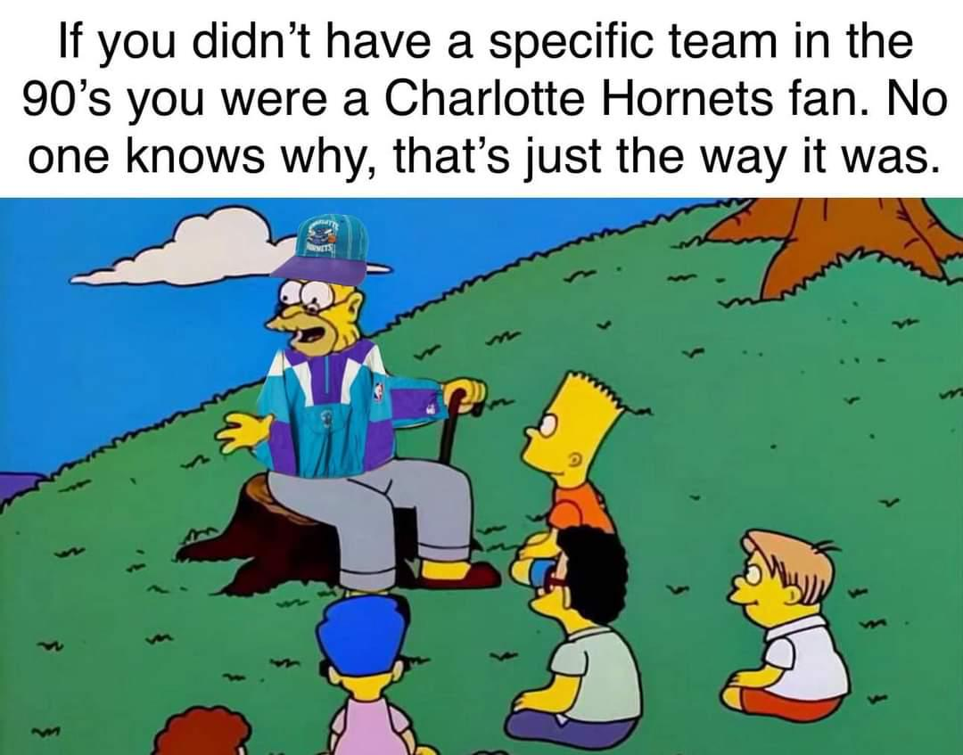

Slide 4
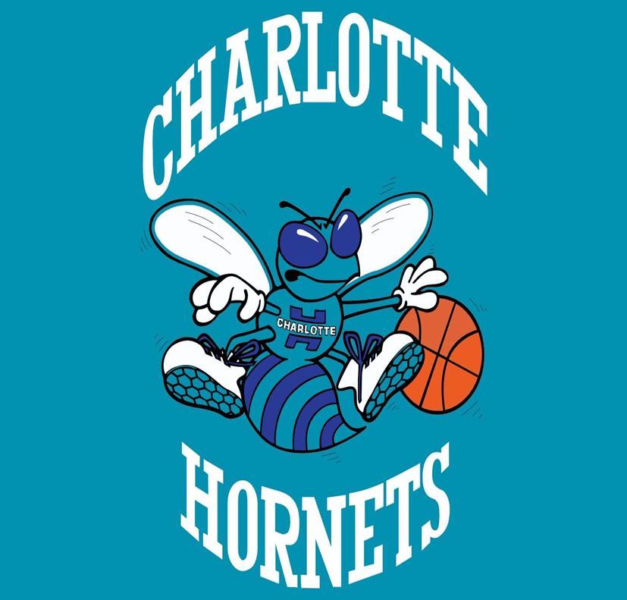
A Brief History
Established in 1988, The Charlotte Hornets are an American professional basketball team based in Charlotte, North Carolina. The Hornets compete in the National Basketball Association (NBA) as a member of the Southeast Division of the Eastern Conference.
The original Charlotte Hornets franchise was established in 1988 as an expansion team owned by George Shinn. In 2002, Shinn moved the franchise to New Orleans. The team continued to play as the Hornets until 2013, when its name was changed to the New Orleans Pelicans.
As part of an agreement with the NBA, a new team known as the Charlotte Bobcats began competing in the 2004–05 NBA season. On June 15, 2006, Michael Jordan, acquired a minority stake in the franchise and became its managing member of basketball operations. On February 17, 2010, an ownership group led by Jordan purchased a majority share of the franchise. In 2013, the Bobcats announced they would begin playing under the Charlotte Hornets name in the 2014–15 season. On the day the name change became official, the franchise reclaimed the history and records of the original Hornets. The Hornets are now retroactively considered as having suspended operations from 2002 to 2004.
In August 2023, Jordan sold his majority stake in the Hornets to a group of investors. He retained a minority share in the ownership of the team.
This is what re-invigorated my interest in this question…

Slide 5
Are the Charlotte Hornets a bad NBA team?
Why?

Slide 6
The Data
Data Source
https://www.nba.com/stats
Compiled NBA team Statistics from 2019 - 2025
What this data does not cover
Front office and Coaching movement
Individual Player Statistics
Injuries
Suspensions
Trades
Salary Cap Spend (Dead Cap)
Drafting

Slide 7
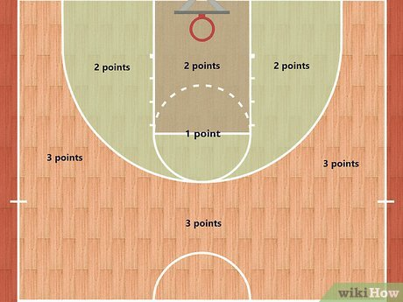
Scoring in Basketball
Points in basketball are used to keep track of the score in a game. Points can be accumulated by making field goals (two or three points) or free throws (one point). The team that has recorded the most points at the end of a game is declared that game's winner. In the NBA, games last for 4, 12 minute periods.

Slide 8
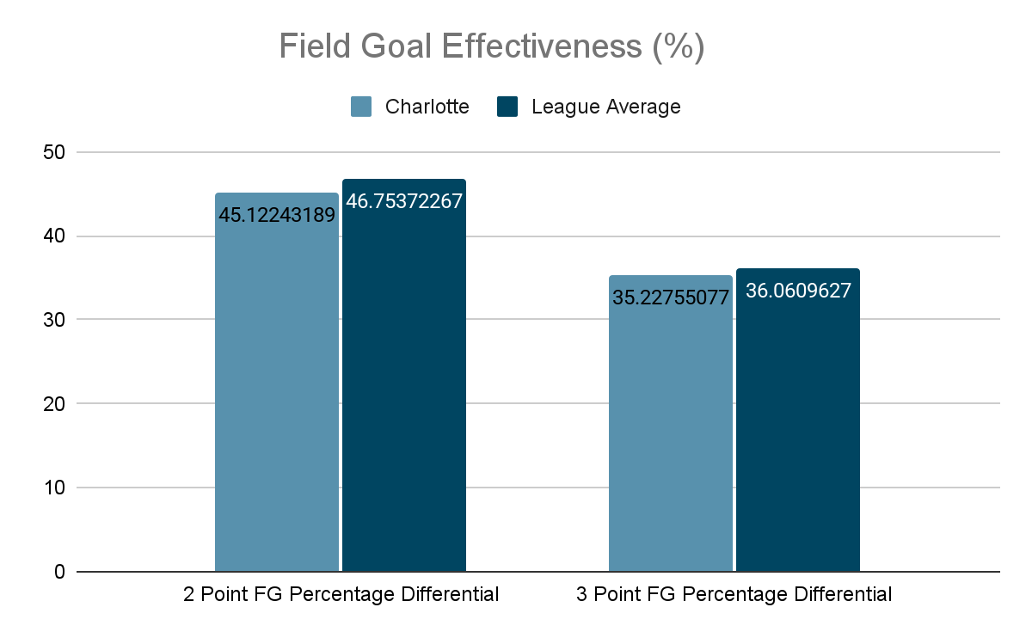
Field Goals (2 & 3 Point shots)
 | Charlotte | League Average
Points Scored | 49671 | 52368
2 point Shots Made | 18317 | 19213
2 point Shots Missed | 22277 | 21833
3 point Shots Made | 5759 | 5871
3 point Shots Missed | 10589 | 10390

Slide 9
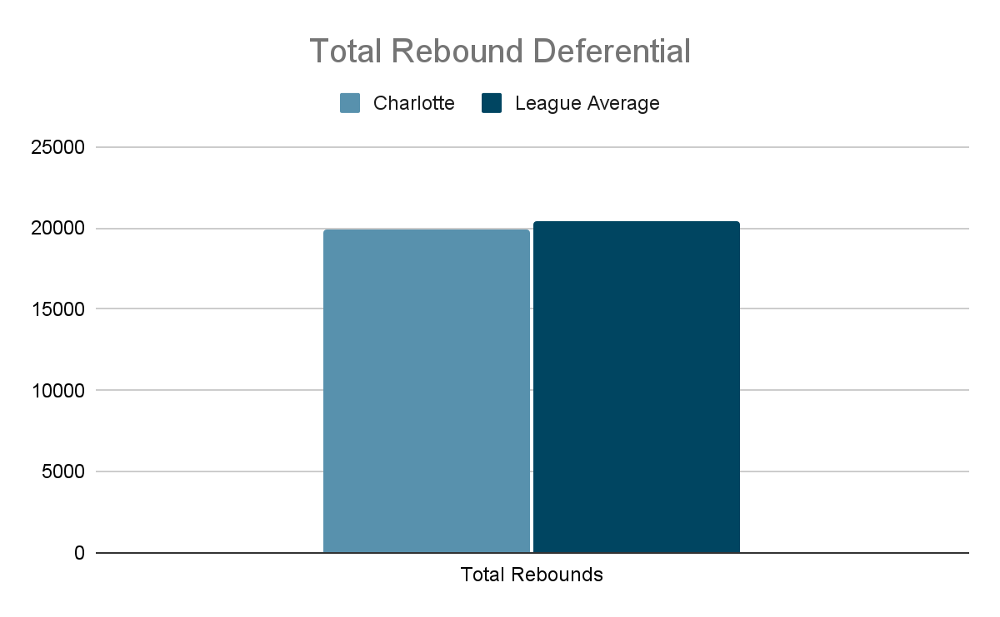
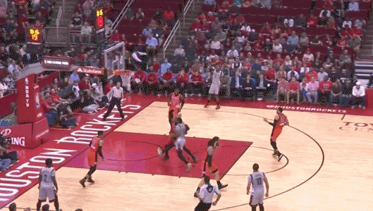
Rebounds
An individual rebound is credited each time a player retrieves a live ball or purposely taps a live ball to a teammate immediately following a missed field goal attempt or a missed free throw attempt.
Charlotte | League Average
19894 | 20414

Slide 10
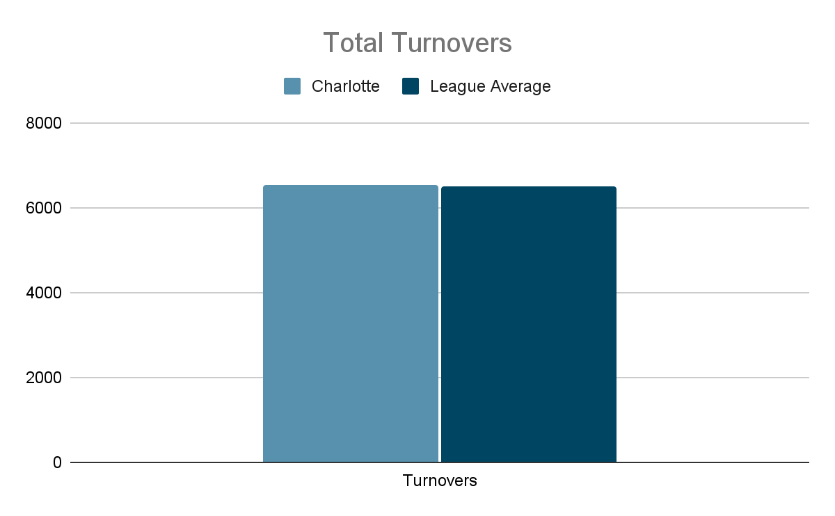
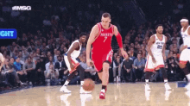
Turnovers
A player is charged with a turnover if they lose possession of the ball to the opposing team before a shot is attempted.
Charlotte | League Average
6538 | 6488

Slide 11
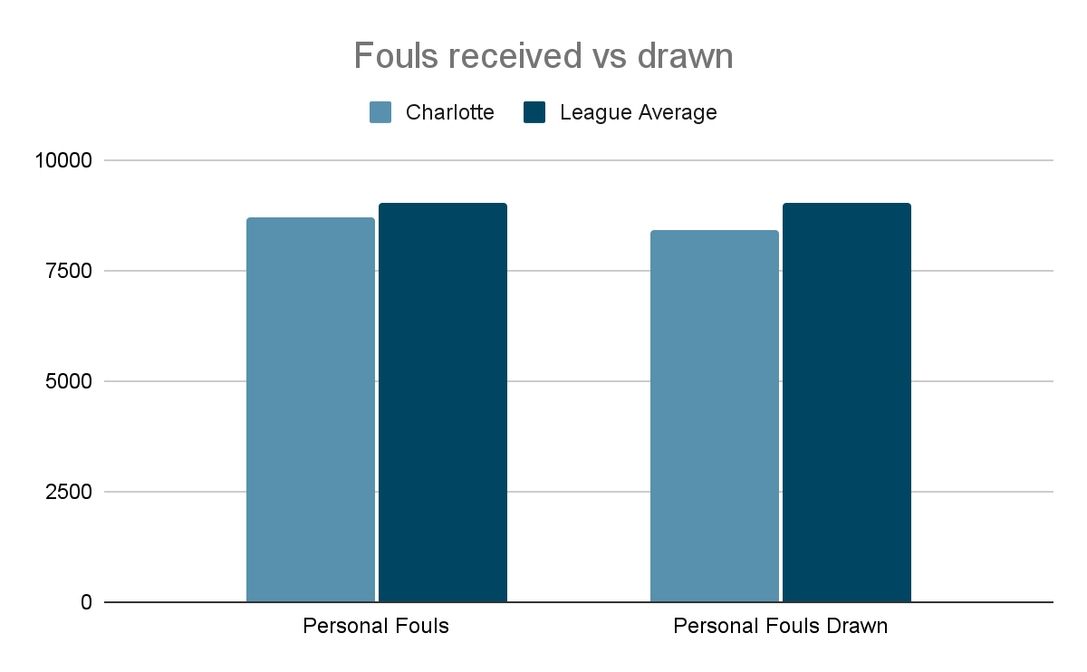
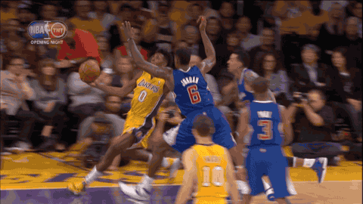
Personal Fouls
Any player whose actions against an opponent cause illegal contact with yet another opponent has committed the personal foul. A personal foul committed by the offensive team during a throw-in shall be an offensive foul, regardless of whether the ball has been released.
NBA Fouls and Penalties defined
 | Charlotte | League Average
Personal Fouls | 8687 | 9044
Personal Fouls Drawn | 8432 | 9042

Slide 12
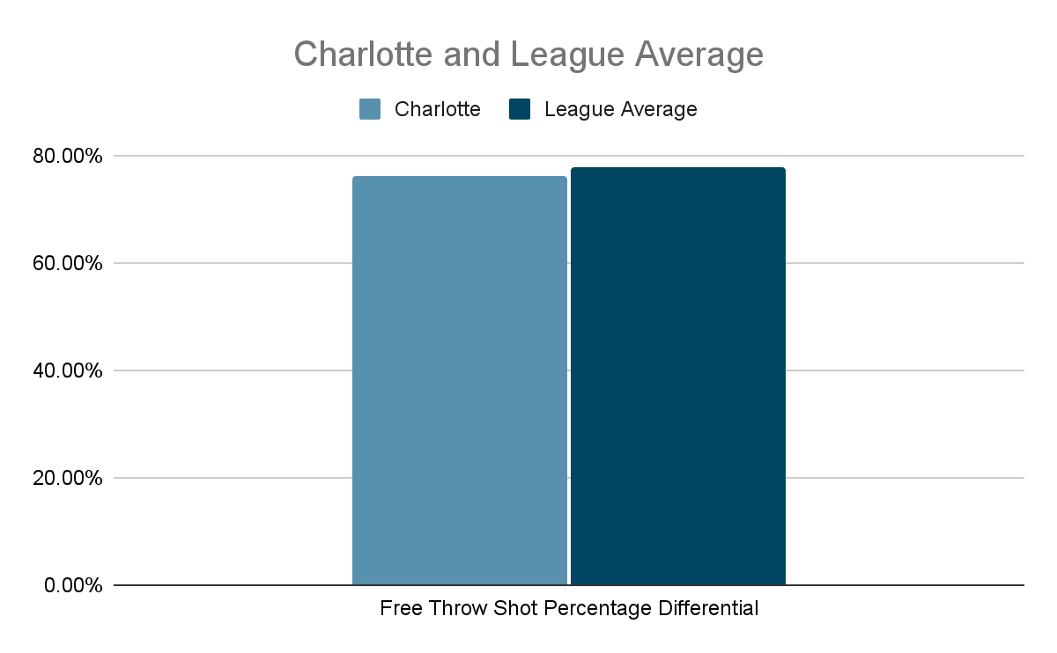
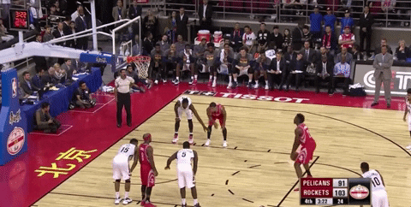
Free Throws
A free throws or foul shots are unopposed attempts to score points by shooting from behind the free-throw line (informally known as the foul line or the charity stripe), a line situated at the end of the restricted area.
Free throws are generally awarded after a foul on the shooter by the opposing team, analogous to penalty shots in other team sports. Free throws are also awarded in other situations, including technical fouls, and when the fouling team has entered the bonus/penalty situation (after a team commits a requisite number of fouls, each subsequent foul results in free throws regardless of the type of foul committed).
Also, depending on the situation, a player may be awarded between one and three free throws. Each successful free throw is worth one point.
 | Charlotte | League Average
Free Throws Made | 7278 | 8069
Free Throws Attempted | 9562 | 10354
FT% | 76.11% | 77.96%

Slide 13
How do these numbers translate into wins for The Charlotte Hornets?

Slide 14
They don’t

Slide 15
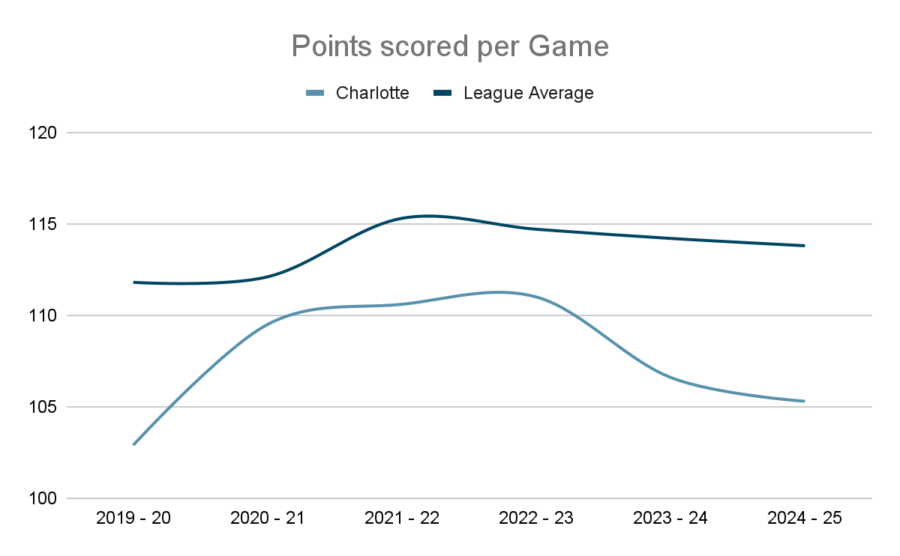
Points Scored per Game

Slide 16
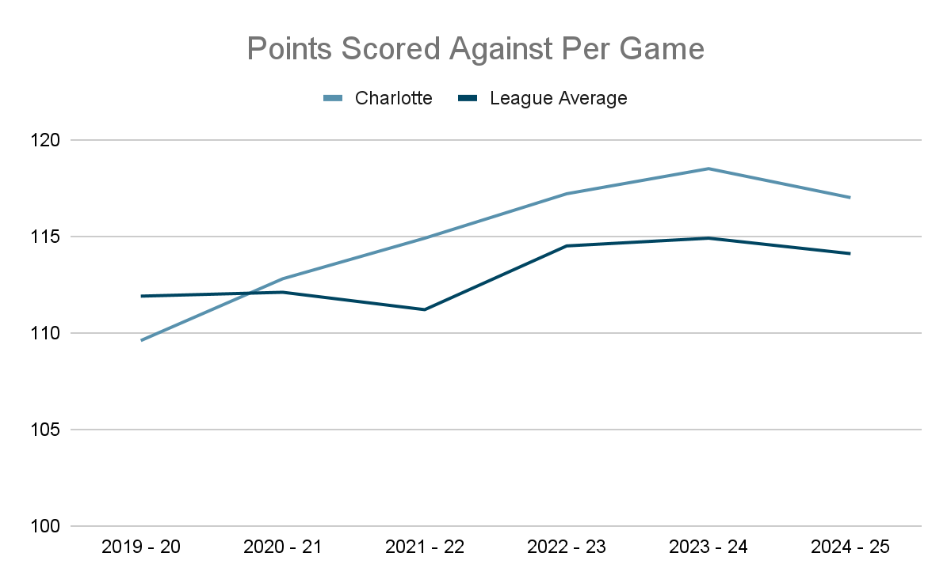
Points Scored Against Per Game

Slide 17
Win/Loss History over last 5 Seasons (2019 - 25)
Season | GP | W | L | W-L% | Finish | Playoffs
2019-20 | 65 | 23 | 42 | 35.4% | 4th | N/A
2020-21 | 72 | 33 | 39 | 45.8% | 4th | N/A
2021-22 | 82 | 43 | 39 | 52.4% | 3rd | N/A
2022-2023 | 82 | 27 | 55 | 32.9% | 5th | N/A
2023-2024 | 82 | 21 | 61 | 25.6% | 4th | N/A
2024-2025 | 82 | 19 | 63 | 23.2% | 4th | N/A

Slide 18
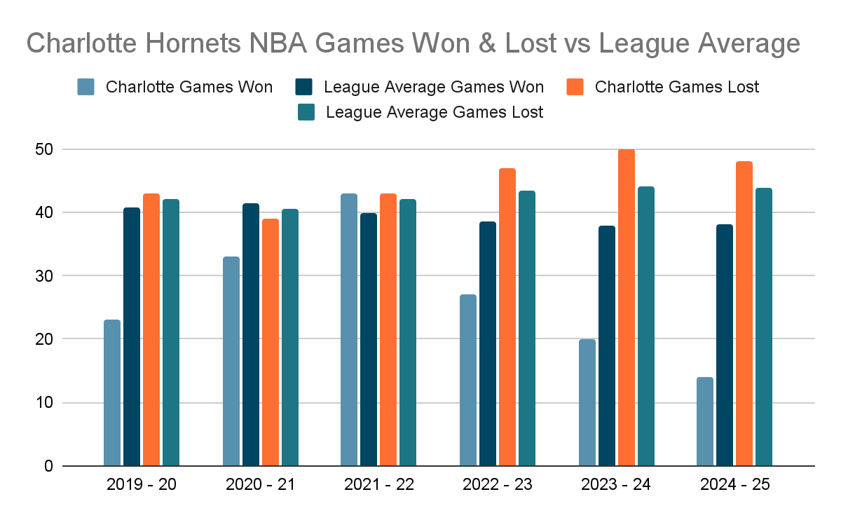
Games Won and Lost Per Season

Slide 19
Charlotte Hornets Franchise Win/Loss Record (1988 - Present)
 | Wins | Losses | Win%
All-time Regular Season Record | 1174 | 1539 | 43.3%
All-time Postseason Record | 23 | 40 | 36.5%
Combined Record | 1197 | 1579 | 43.1%

Slide 20
So what needs to change?

Slide 21
EDA and hypothesis Analysis
From the data supplied, we can infer the following:
Shooting Inefficiency: Charlotte’s field goal percentage differential and three-point percentage differential are also lower than the league average, suggesting they are less efficient in shooting.
Rebounding and Turnover Issues: Charlotte also struggles with rebounding and has a negative turnover differential, meaning they are being outrebounded and committing more turnovers.
Low Point Differential: The Charlotte Hornets have a significantly lower point differential compared to the league average, indicating they are being outscored by their opponents.
Impact on Wins: The linear regression model and correlation matrix show a strong positive correlation between point differential and wins. The Hornets' low point differential directly contributes to their fewer wins.
Conclusion: In the multi-billion dollar industry of profession sport, being just a percent off the pace in multiple statistical categories that have a negative correlation with wins.

Slide 22
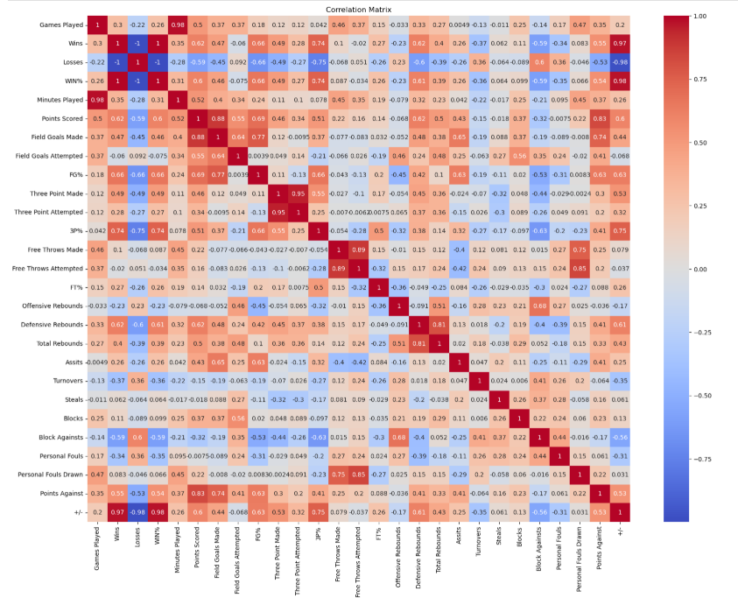

Slide 23
But is it really that simple?

Slide 24
The Starting 5 (6)
Name | Position | Age | Years Pro | Salary | Games Played | Season Ending Injury
LaMelo Ball | PG | 23 | 5 | $35,147,000 | 47 | Yes
Miles Brides | SF | 27 | 6 | $27,173,913 | 64 | No
Jusuf Nurkic | C | 30 | 12 | $18,125,000 | 51 | No
Grant Williams | PF | 26 | 7 | $13,025,250 | 16 | Yes
Josh Green | SG | 24 | 5 | $12,654,321 | 68 | No
Brandon Miller | F | 22 | 2 | $11,424,600 | 27 | Yes

Slide 25
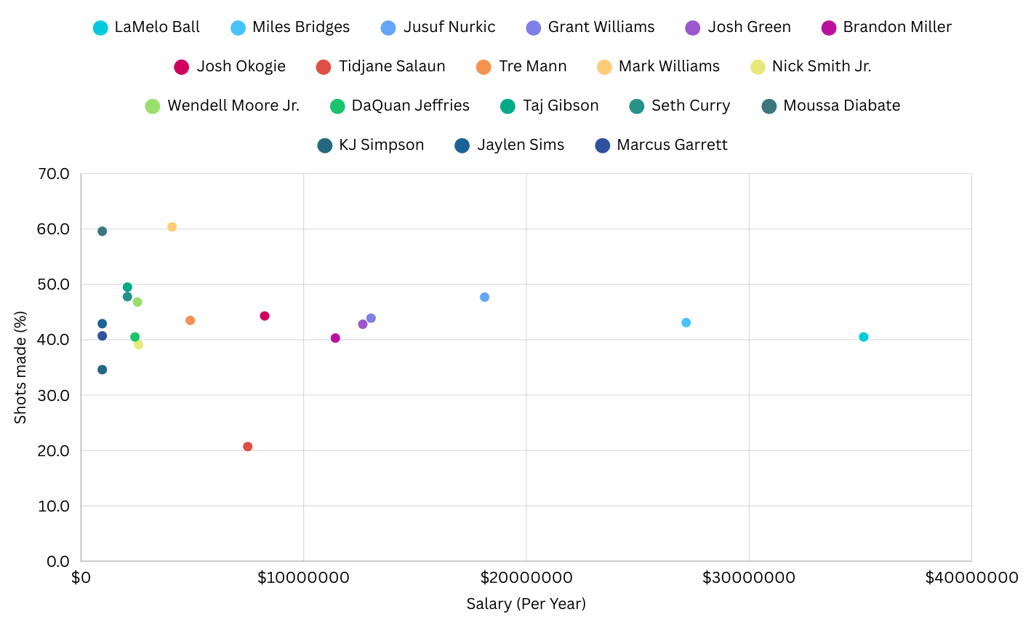
FG Made % in 2024-25 Season

Slide 26
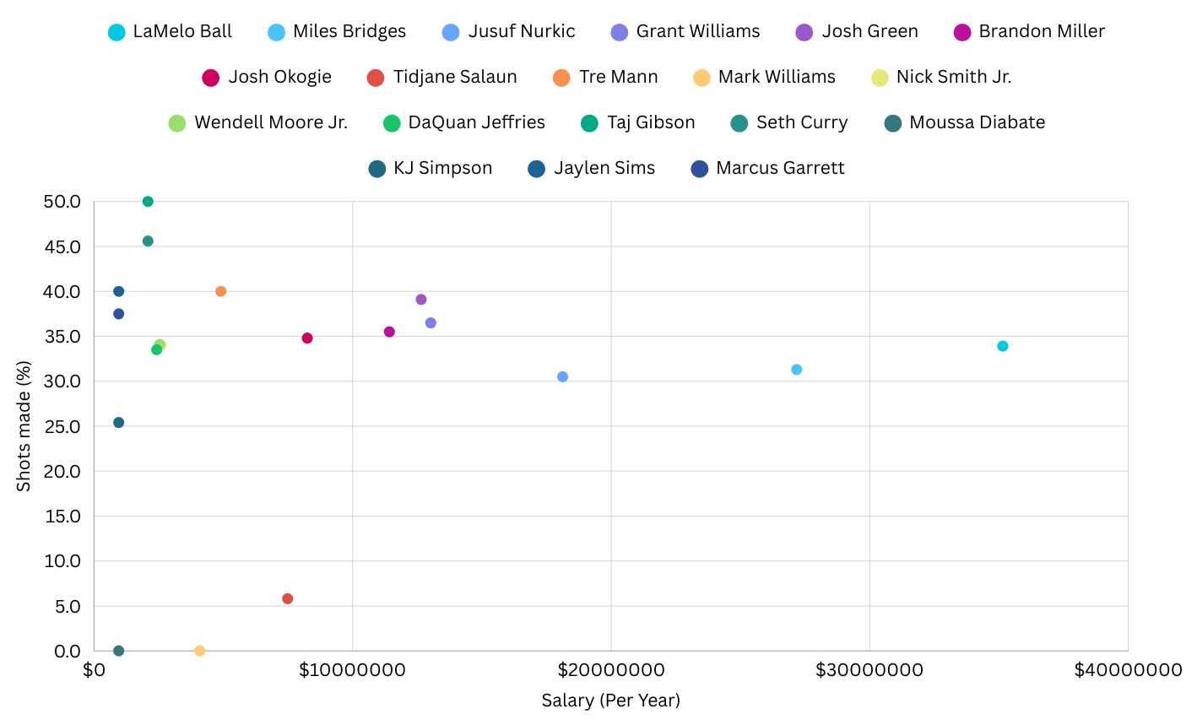
3PT Made % in 2024-25 Season

Slide 27
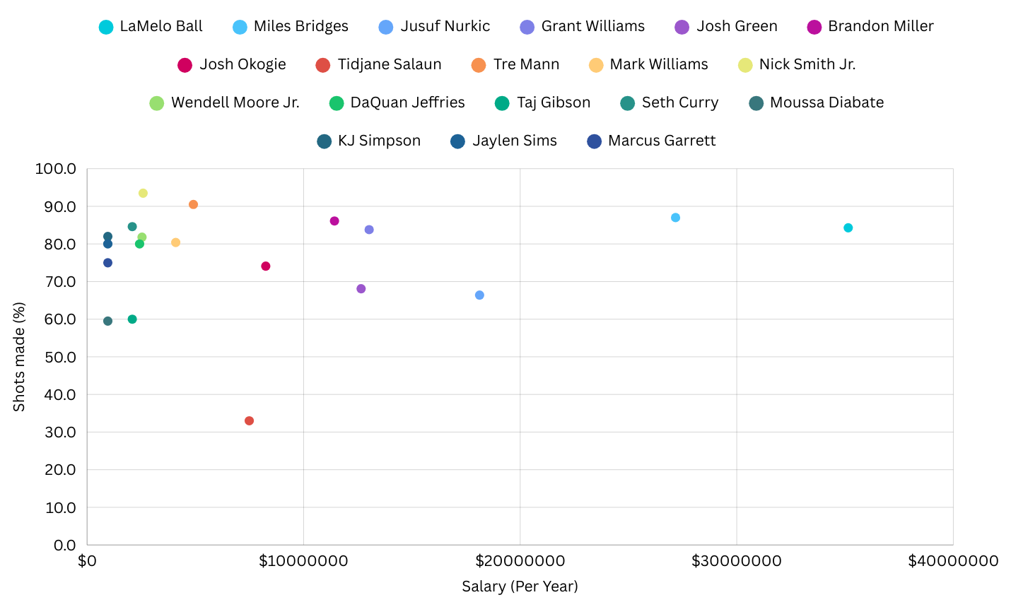
FT Made % in 2024-25 Season

Slide 28
How do they start winning again

Slide 29
Winning starts in the front office
Ownership
General Management
Coaching - Coach a game plan that focus’ on defence, obtaining rebounds and high percentage shots whilst eliminating turnovers. Coach Charles Lee was in his first year this season.
Drafting and free agency - Need to draft and sign players that have a focus on defense, and high shooting percentages. Charlotte are projected to win the draft lottery this year and therefore, get first pick in the draft to select the best players coming out of College this year
Injuries - Injuries to star players has caused a substantial amount of reshuffling to the team. For the 2024–25 season, the cap is set at $140.588 million. Out of the $140.588 Million, there was over $59.596 Million in injured players for over half the season. More than half the allocated salary cap.

Slide 30
Thank you!

